Slide 1
PEP Input Class
Presented By
Kanika Sharma

Slide 2
Topics to be covered…
one dimensional array,
Array initialization,
2 D array,
initialization and matrices related concepts

Slide 3
Arrays
A linear array is a list of a finite number of homogeneous data elements such that: a. All elements are indexed. b. Elements are stored in successive memory locations.
To obtain the length of data elements of the array we can subtract the largest index by the smallest called as upper bound UB and lower bound LB respectively and adding 1
Length = UB - LB + 1

Slide 4
Address calculation
If we know the base address of the array we can easily figure out the address of any location of the index of the array by simply using this method.
Location arr[k] = BaseLocation(arr[0]) + w x(k - LowerBound)
w = Number of words per memory cell

Slide 5
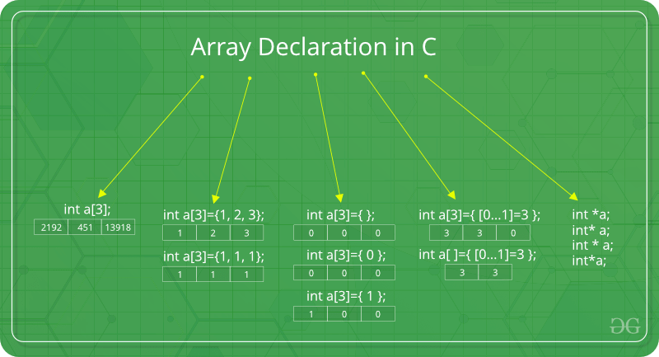
Arrays in C++
++

Slide 6
Array Pointer
An array name is a constant pointer to the first element of the array.
for ( int i = 0; i < 5; i++ ) {
cout << "*(p + " << i << ") : ";
cout << *(p + i) << endl;
}
cout << "Array values using array
as address " << endl;
for ( int i = 0; i < 5; i++ ) {
cout << "*(arr+ " << i << ") : ";
cout << *(arr + i) << endl;
}
return 0;
}
#include <iostream>
using namespace std;
int main () {
int arr[5] = {1,2,3,4,5};
int *p;
p = arr;
cout << "Array values using pointer " << endl;

Slide 7
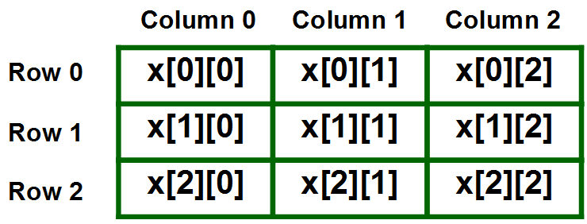
2- D arrays

Slide 8
Initialization of 2-D arrays
Method 1 : int x[3][4] = {0, 1 ,2 ,3 ,4 , 5 , 6 , 7 , 8 , 9 , 10 , 11}
Method 2: int x[3][4] = {{0,1,2,3}, {4,5,6,7}, {8,9,10,11}};
Method 3:using nested for loop
Method 4: Dynamic memory allocation
int** x = new int*[3];
for(int i = 0; i < 3; i++)
{ x[i] = new int[4];
for(int j = 0; j < 4; j++)
{ cin >> x[i][j];
}
}

Slide 9
Matrix operations
Addition
Subtraction
Multiplication
Sum of diagonal elements matrix

Slide 10
Predict the output
#include <iostream>
using namespace std;
int main()
{
int a[] = {0, 0X4, 4, 9};
int i = 2;
cout<< a[i] <<i[a];
return 0;
}

Slide 11
Solution
4 4

Slide 12
Predict the output
#include <iostream>
using namespace std;
int main()
{
int a[] = {10, 20, 30, 40, 50};
int *p;
p = a;
cout<< *((int *)p + 3);
return 0;
}

Slide 13
Solution
40

Slide 14
Predict the output
#include <iostream>
using namespace std;
int main()
{
int array[] = {10, 20, 30};
cout <<-1[array];
return 0;
}

Slide 15
Solution
-20

Slide 16
Debug the code
#include <iostream>
using namespace std;
int main()
{
int a = 5, b = 10, c = 15;
int arr[3] = {&a, &b, &c};
cout << *arr[*arr[1] - 8];
return 0;
}

Slide 17
Error
error: invalid conversion from ‘int*’ to ‘int’

Slide 18
Predict the output
#include <iostream>
using namespace std;
int main()
{
int arr[] = {4, 5, 6, 7};
cout << *arr + 9;
return 0;
}

Slide 19
Answer
13

Slide 20
Finding the largest element from array
#include<bits/stdc++.h>
using namespace std;
int main(){
int arr[]={10, 89, 67, 56, 45, 78};
int n = sizeof(arr)/sizeof(arr[0]);
int max_element = INT_MIN;
for(int i=0; i<n; i++)
{
if(arr[i]>max_element)
max_element = arr[i];
}
cout<<max_element;
}

Slide 21
Hands On Exercise 1
A chocolate factory is packing chocolates into the packets. The chocolate packets here represent an array of N number of integer values. The task is to find the empty packets(0) of chocolate and push it to the end of the conveyor belt(array).
Example 1 :
N=7 and arr = [4,5,0,1.9,0,5,0].
There are 3 empty packets in the given set. These 3 empty packets represented as O should be pushed towards the end of the array

Slide 22
Exercise 2
A supermarket maintains a pricing format for all its products. A value N is printed on each product. When the scanner reads the value N on the item, the product of all the digits in the value N is the price of the item. The task here is to design the software such that given the code of any item N the product (multiplication) of all the digits of value should be computed(price).

Slide 23
References
https://www.geeksforgeeks.org/top-50-array-coding-problems-for-interviews/

Slide 24
Thanks.

